Slide 1
Padma Bridge
Kamrul Islam Tushar
ID: 011 141 139
Rafid Asrar Prottoy
ID: 011 132 124

Slide 2
About Project
As one of the hot topic among us this day is regarding Padma Bridge.
This bridge is going to bring revolution to the transportation & communication sector
A dream for the Bangladeshis who lives on the southern part of Bangladesh.

Slide 3
About Project (Cont.)
The view option consists of two main part.
1: Above the river
2: Ground Part
Two Main Transportation system:
1. Cars & Heavy vehicles
2. Train ( Below the bridge)

Slide 4
Task Distribution
Rafid Asrar Prottoy
Collecting pictures & editing them
Drawing Cars
Texturing grass/river/sky image
Creating Bridge
Kamrul Islam Tushar
Drawing The trains
Moving objects
Creating Bridge
Keyboard functions

Slide 5
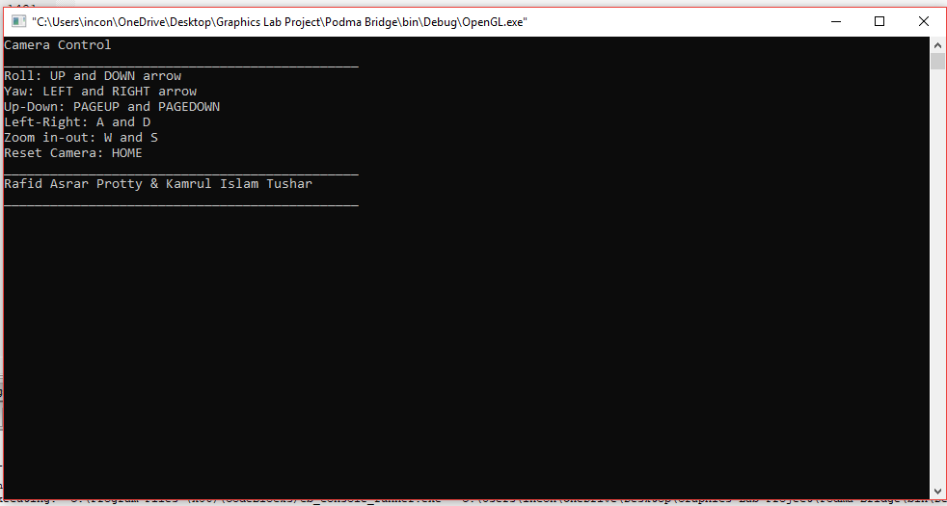

Slide 6
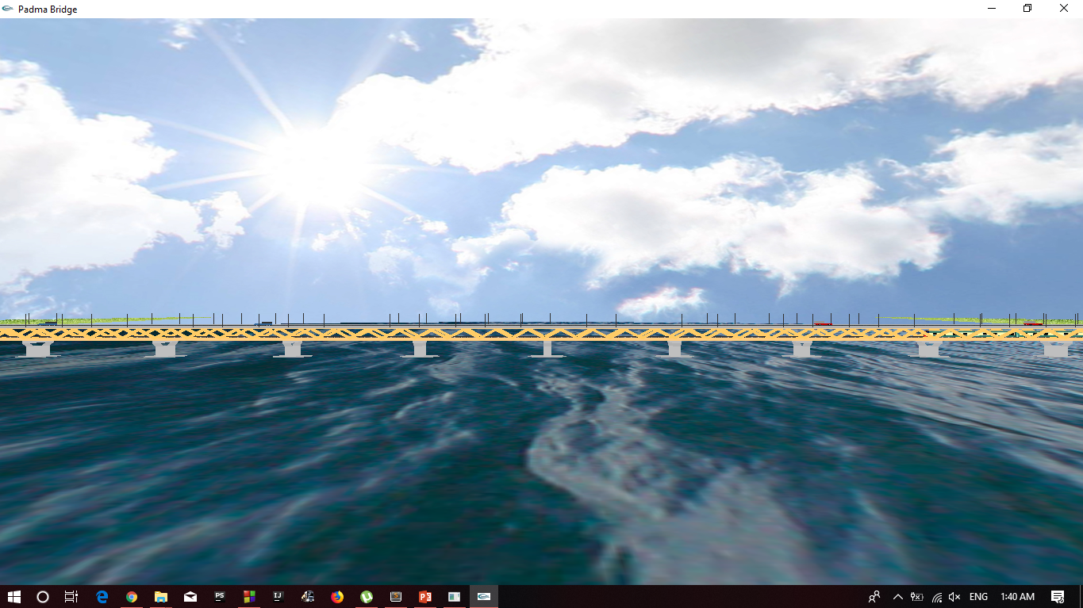
Screenshots

Slide 7
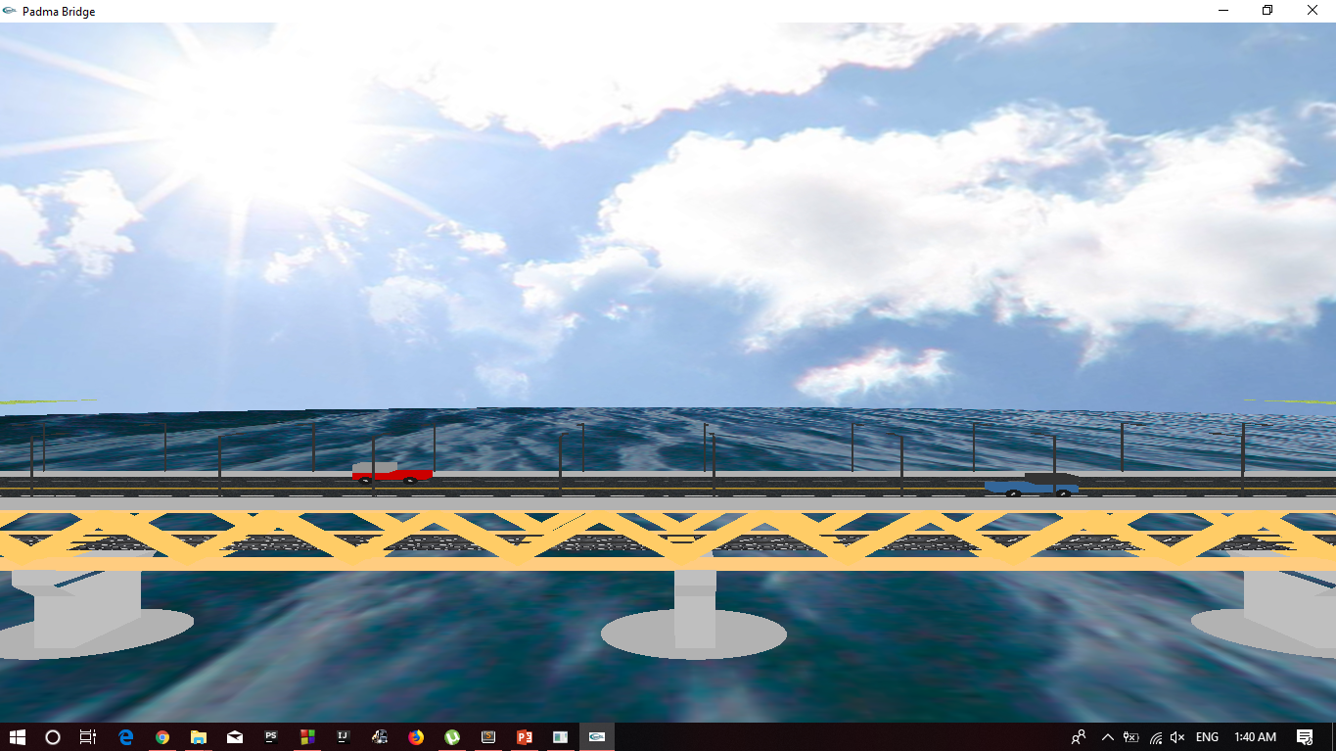

Slide 8
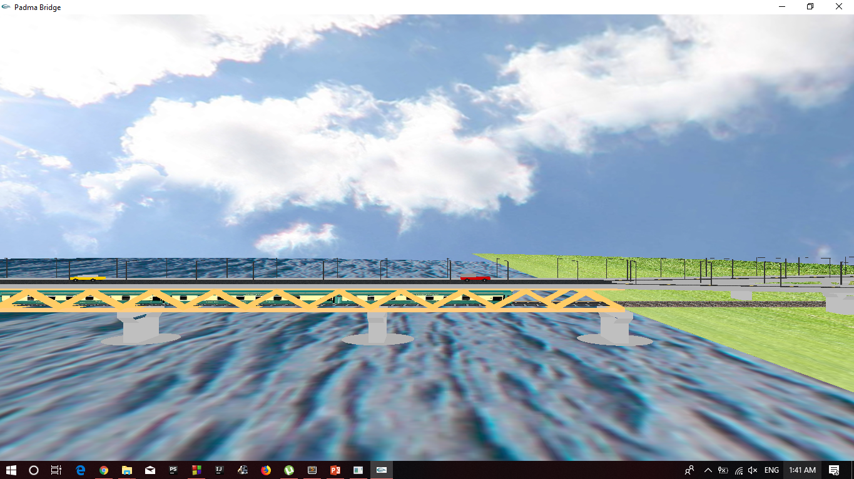

Slide 9
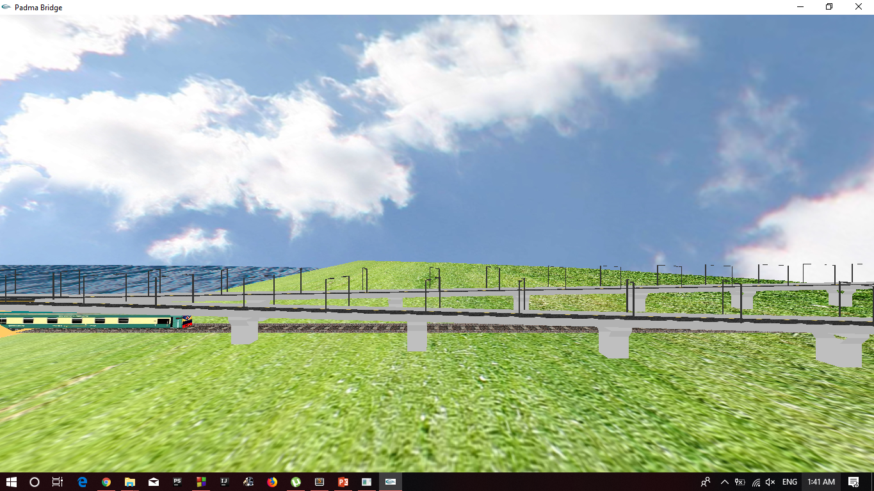

Slide 10
Thank You

